Slide 1
Room Occupancy Estimation
Karthikeyan Ravichandran
Tejas Murali
Sunil Kumar Kommineni
Pooyan Ghodrati
Lekha Chittajallu
Vineeth Yadama

Slide 2
General Overview
The Room Occupancy Estimation dataset contains information about how different factors can help gauge the number of occupants in a room
These can include temperature, light, sound, CO2 level, and PIR
In this project, EDA is done to understand how these features can correlate and affect the target variable, the Room Occupancy Count.
Different ML models are then used, coupled with different methods such as feature selection and the highest performing one is chosen
Purpose and applications of the project include optimizing resource utilization, energy and cost-efficiency, technology, security, and indoor lifestyle

Slide 3
Data description, pre-processing, and EDA
Experiment
Dimensions of the room used for testing are 6m x 4.6m, consisting of several sensor nodes outputting data to a main edge node
These sensors are either temperature, light, sound, CO2, or PIR
Sensors are calibrated or adjusted to the appropriate sensitivity levels and detect corresponding signals, motion, or conditions
Data was collected for 4 days, and the Room Occupancy count varied between 0 to 3 people
Pre-processing and EDA
Data pre-processing is an important first step to take before undergoing EDA and using ML algorithms
First, missing and duplicate values are taken care of by dropping rows with missing values, filling them in with mean, median, or mode of the features, or using other deletion and imputation methods
Outliers are then also identified by either using statistical approaches like finding the IQR or visualization like box plots
Finally, basic EDA and other visualization is then done, for example, creating pie charts or noting further correlations using heat maps

Slide 4
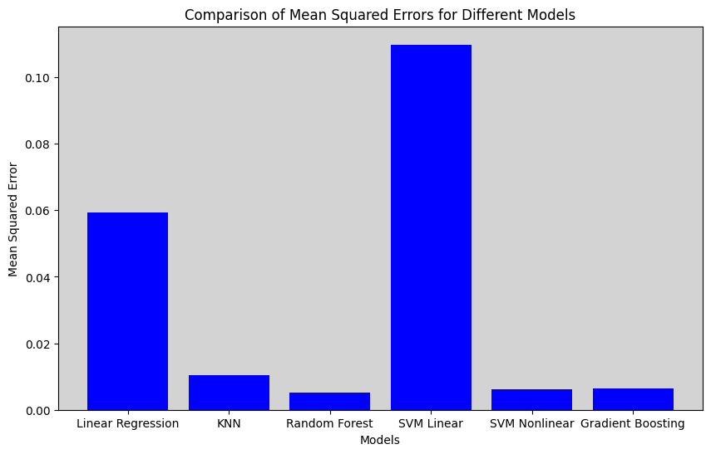
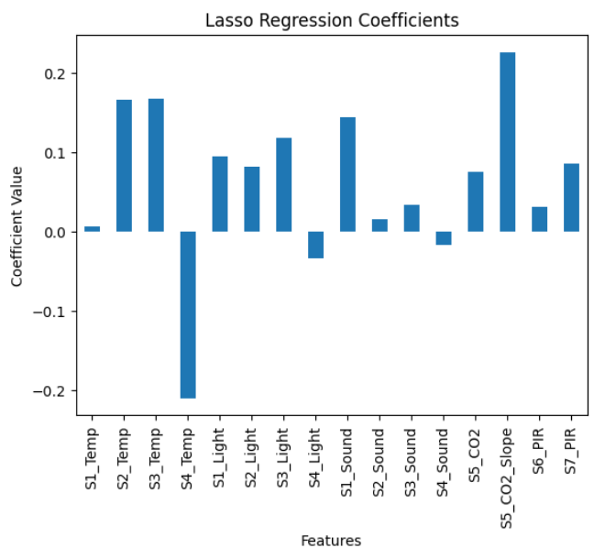
Initial training of models
First, more EDA is done on the model. The features (X) and target variable (y) is then split into training and testing data sets
After scaling is done, the models are initially trained without hyperparameter tuning
The error for the models is then compared using a bar plot. Random Forest is considered the best model so far because it has the lowest Mean Squared Error

Slide 5

Hyperparameter tuning
In hyperparameter tuning, a validation set is used to tune the hyperparameters, which are preset values that are basically analogous to the configuration settings of the model that can be adjusted to optimize model performance
Grid search or random search is used to explore a range of possible hyperparameter combinations.
Grid search evaluates predefined hyperparameter values
Random search randomly samples hyperparameter values within specified ranges

Slide 6
Variance-bias tradeoff and Cross Validation
The Bias-Variance tradeoff basically highlights how bias and variance are inversely related – as one increases, the other decreases
Adjusting the complexity of the model influences the bias and variance
Increasing the complexity increases variance but decreases bias
Decreasing the complexity can increase bias but decrease variance
High bias is underfitting, while high variance is overfitting
Cross Validation is a resampling technique that involves partitioning the data into subsets, training the model on some of them, and evaluating the remaining subsets. It is great for detecting overfitting and underfitting

Slide 7
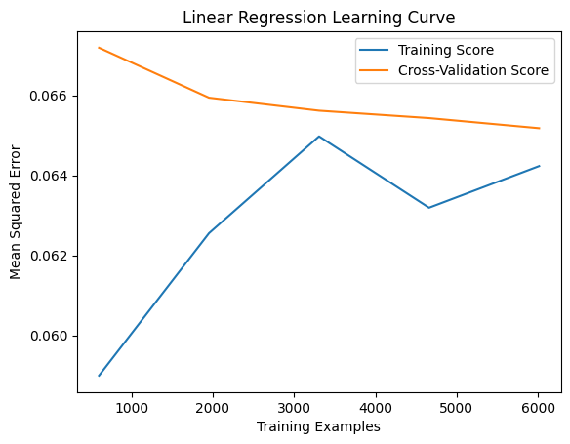

Linear Regression
Linear Regression is a statistical approach for modeling the relation between a dependent or target variable (y) and one or more independent variables or features (x)
The independent variables and dependent variable are assumed to be linearly related
As seen in the graph, Linear Regression involves
high variance and low bias with low training
samples and then switches to low variance and high
bias as more samples are added. The error for Linear
Regression is quite high, and it is not a good model

Slide 8
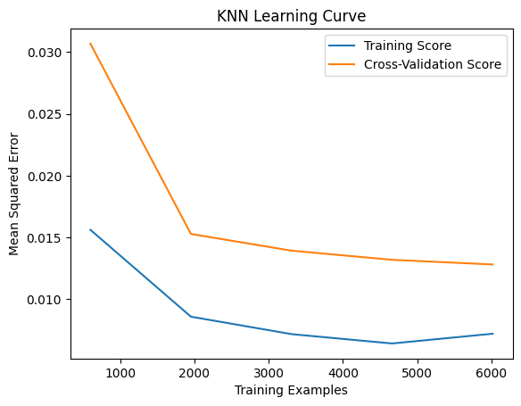

K Nearest Neighbors
K Nearest Neighbors (KNN) is a Machine Learning algorithm used for both classification and regression
Given a new data point, the ‘K’ nearest neighbors, which are the closest training data points, are considered. Predictions are made based on the majority class (classification) or average (regression) for those neighbors
As seen in the graph, KNN involves high variance
and low bias with low training samples and then
switches to low variance and low bias as more
samples are added. The error for Linear Regression
is quite low, and it is a decent model

Slide 9
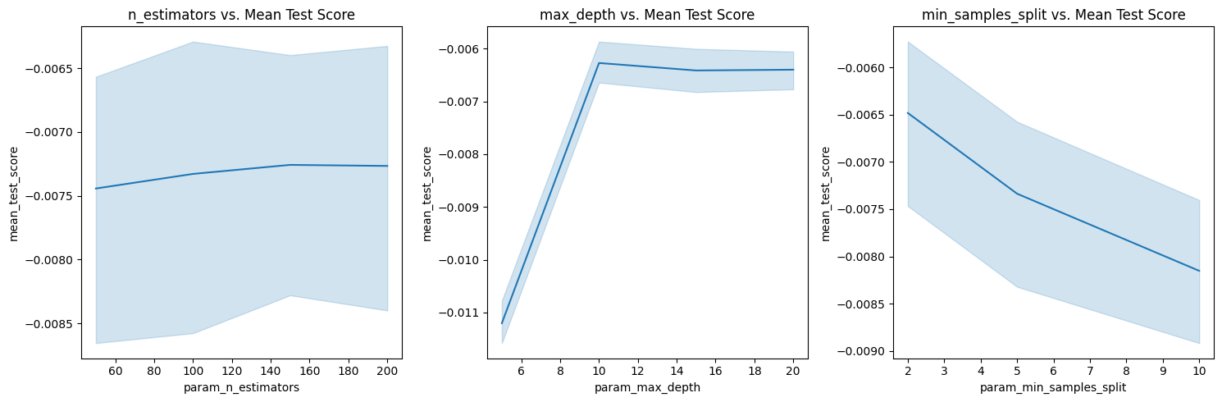
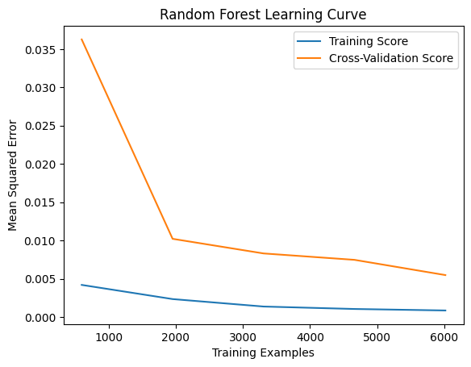

Random Forest
Random Forest is an ensemble learning method that involves several decision trees during training and joins them to improve prediction accuracy and stability
As seen in the graph, Random Forest involves high variance and low bias with low training samples and then switches to low variance and low bias as more samples are added. The error for Random Forest is quite low, and it is a decent model

Slide 10
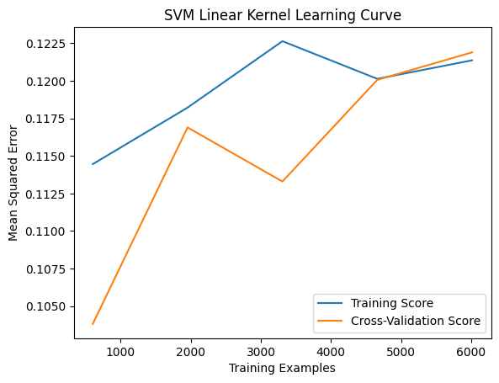

Support Vector Machines
SVM with Linear kernel is designed for data that is linearly separable. It finds the hyperplane that best separates the classes by maximizing the margin, which is the distance between the hyperplane and the nearest data points of each class
As seen in the graph, SVM involves high variance
and low bias with low training samples and then
switches to low variance and high bias as more
samples are added. The error for SVM linear
is quite high, and it is not a good model

Slide 11
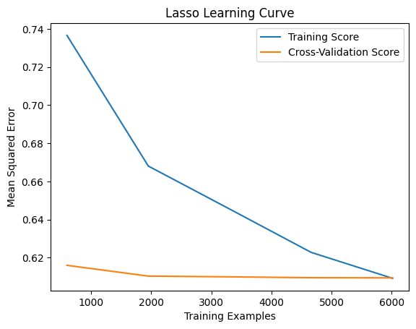

Lasso Regression
Lasso regression, or L1 regularization, is an extension of Linear Regression that introduces a penalty term to the loss function to help prevent overfitting.
Works by shrinking certain coefficients to zero and it is useful for higher dimensional datasets where unnecessary features can be excluded from the model
As seen in the graph, L1 Regression involves
high variance and low bias with low training
samples and then switches to low variance and
low bias as more samples are added. The error
for Lasso Regression is quite high, and it is not
a good model

Slide 12
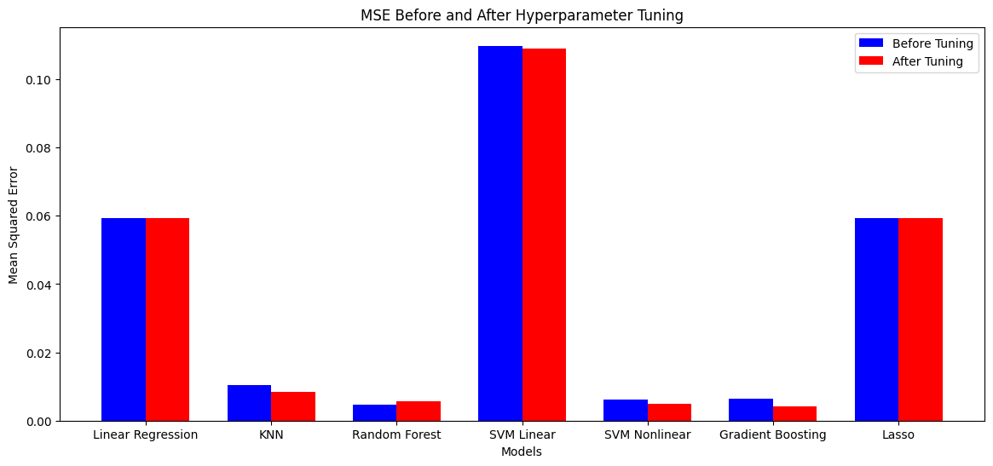
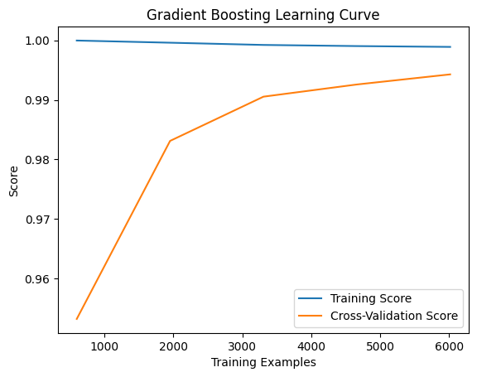

Gradient Boosting
Gradient Boosting is an ensemble learning model that builds a predictive model in a stagewise fashion by combining the predictions of multiple weak learners, often decision trees, to create a strong predictive model
As seen in the graph, Gradient Boosting involves high variance and low bias with low training samples and then switches to low variance and high bias as more samples are added. The error for Gradient Boosting is the lowest, and it is the best model

Slide 13


Wrapper Methods
Used for assessing the performance of a model by using subsets of features and are guided by predictive performance of the model
Forward selection – Adds features one at a time, and selects the one that improves model performance the most
Backward elimination – Starts with all features and removes one at a time, eliminating the one with the least impact on performance
Recursive feature elimination (RFE) – Removes the least important features based on model performance through an iterative process
Bi-directional elimination – Can go in either direction during the feature selection process

Slide 14

Advanced Models
XG Boost
Ensemble learning model that gained popularity for high performance in various machine learning tasks
Particularly effective in structured or tabular data and is an extension of the gradient boosting framework
Combines predictions from multiple weak models to produce a strong model
ANN with 2 hidden layers
An ANN model with 2 hidden layers is a type of deep learning model that consists of an input layer, 2 hidden layers, and an output layer
Each layer is consisted of interconnected nodes or neurons, which have weights that are constantly updated during the training process
The model is trained on a labeled dataset, where it learns to make predictions by adjusting the weights based on the training data. Backpropagation is used to propagate errors backward through the network and fix the weights
Extreme Machine Learning Model
A type of ML algorithm for regression, classification, and feature learning
Known for simplicity and fast training speed
Randomly generates input-to-hidden layer weights and analytically determines the output weights. Particularly used for large scale problems
Ensemble Model
Machine learning technique that combines predictions from multiple individual models to make a more robust and accurate prediction than any of the individual models alone
Fundamental idea behind ensemble modeling is that the combination of diverse models can help mitigate individual model weaknesses and capture a more comprehensive representation of the underlying patterns in the data
An ensemble involves selecting diverse base models, training them independently, and then combining their predictions

Slide 15
